Slide 1
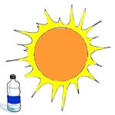
Delgado Safety Topic
Recognition and Prevention of Heat Related Illnesses
Prepared by: Corey Valdary

Slide 2
Purpose
To understand the causes and preventive measures to eliminate heat stress during the Spring/Summer
During both the Spring/ Summer months in Louisiana most work areas are at a high risk for environmental related Heat Stress.
We need to be prepared to handle stress both at work and in our recreational activities away from work
Heat Stress can have deadly consequences
Heat Stress is not an accident, it is preventable
“Be aware and be prepared”
Notes:
Slide 2 our objective
Facts
Past 3 years
BHI USL had 3 recordable heat stress cases
BJ USL had 46 recordable heat stress cases
Stress objectives.
We can become Blasé about heat stress.
May have been to numerous heat stress sessions before.
May not have been affected by heat stress before.
But if we do not remain vigilant we do not remain prepared

Slide 3
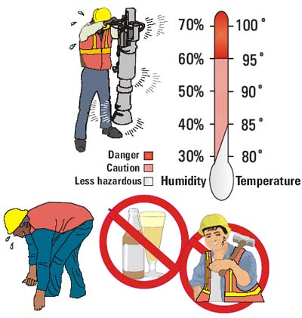
What do we Need to Know ?
What is Heat Stress?
How do we prevent it from occurring?
What do we do if/when it happens to us ?
Notes:
Slide 6 What do We Need to Know?
What is Heat Stress?
How do we prevent it occurring?
What do we do if it happens?

Slide 4

What is Heat Stress?
Heat Stress is the effect from the heat load that a worker is exposed to from the combination of:
HEAT STRESS
Environmental Factors
Metabolic Heat
Temperature
Humidity
Air movement
Radiant Heat
Own physical activity
Clothing Factors
Permeability
Weight
Notes:
Slide 7 What is heat stress.
Reduce activity reduces incidence of heat stress.
Clothing. Long sleeve shirts and pants protect from the heat.
Body can become hot enough it looses its ability to cool down.
As we become acclimatized increase our ability to cool down

Slide 5
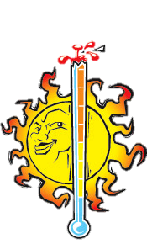

Heat Disorders & Health Effects
Heat Stroke
Heat Exhaustion
Heat Cramps
Heat Collapse “Fainting”
Heat Rashes
Heat Fatigue

Slide 6

Maintaining Body Temperature
HEAT LOSS
HEAT GAIN
In very hot environmental conditions, evaporation of sweat is the body’s primary means of cooling.
Problems begin if the body cannot lose heat quickly enough, resulting in a rise in body temperature.
Notes:
Slide 8.

Slide 7
Impact of Fluid Loss Due to Excessive Heat Loading
During heavy work, body can lose 1-2 quarts of water per hour.
Impacts to the body due to fluid loss
  After 2-3 hours of fluid loss:
  • Lose endurance • Become thirsty
  • Become uncomfortable • Feel hot
  After 3 hours, you may experience:
  • Headaches • Muscle fatigue • Nausea
  • Loss of strength • Heat cramps
  • Loss of accuracy and dexterity
  • Reduced alertness
Notes:
Rehydration is a key factor in prevention of heat stress. These are the symptoms from fluid loss.

Slide 8
How do we Prevent it?
The best defence against heat stress is:
Have frequent, small drinks
Evaluate and manage your environment
Acclimate to the region
Take regular breaks from the heat when working or performing recreational activities outside
Notes:
Slide 9.
When you come into field essential that you acclimatize.
Cannot over emphasizes hydration
Rest breaks, cool rooms, shade structures, reschedule work.
Tool box discussion.
Rotation through jobs

Slide 9
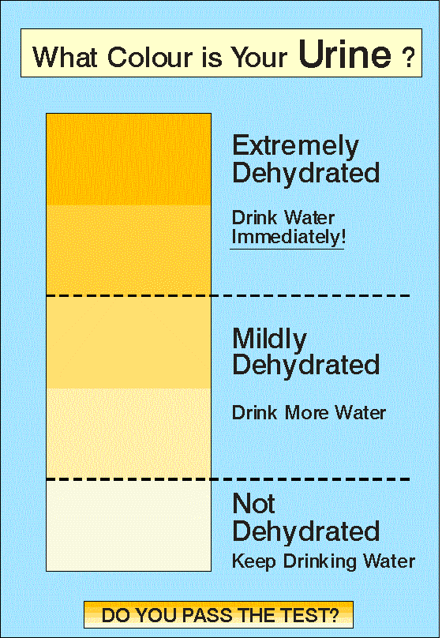
Prevention – Water Consumption
Water should be consumed on regular intervals.
This includes the night before or on days off!

Slide 10
Prevention - Fitness for Work
Before you perform outside activities you have a responsibility to ensure that you are fit for the work/outside activities
Delgado Employees who perform outside duties, must be mindful that If you are ill (flu, gastro, vomiting, viral illnesses) you must inform your Supervisor and seek medical advice
If you have been ill recently - you must also inform your Supervisor prior to starting work
Please be sensible about alcohol consumption and always re-hydrate with water before going to bed and before commencing work
Come to work prepared to work in the heat
Notes:
Slide 10 Fitness for work.
We are all responsible to ensure we are fit for work.
Highlight de-hydrating effects of alcohol and caffeine based drinks.
Alcohol in moderation. Alcohol free days
Gastro. Highlight the dehydrating effect. Difficult to replace fluids. Seek medical advice

Slide 11
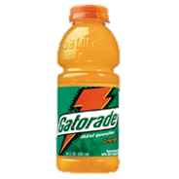
Prevention – Be an Industrial Athlete
Maintain a diet conducive to working in extreme heat.
Do eat and drink:
  Water
  Gatorade or other drinks rich in electrolytes.
    The rule of thumb is to consume 1 bottle of water for every sports drink consumed. The sugars and potassium in those drinks are good, but only if you have enough clean fluid (water) to transfer all the goodness to your body without taxing the liver and kidneys. If you're just consuming sports drinks, it creates a syrupy fluid level in your body which can take a toll on your organs.
  Fruits such as:
    Kiwi
    Watermelon
    Blueberries
    Cranberries
    Frozen fruits are a great source
  Salty Foods:
    Pickles, Olives, and Almonds.
Notes:
Slide 10 Fitness for work.
We are all responsible to ensure we are fit for work.
Highlight de-hydrating effects of alcohol and caffeine based drinks.
Alcohol in moderation. Alcohol free days
Gastro. Highlight the dehydrating effect. Difficult to replace fluids. Seek medical advice

Slide 12
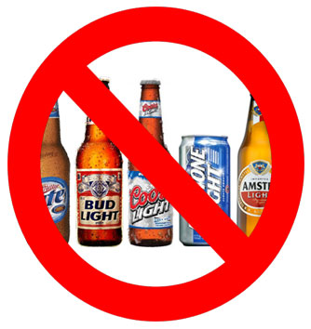
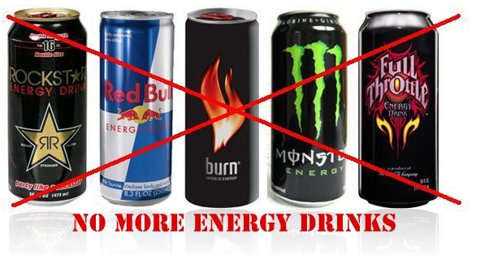
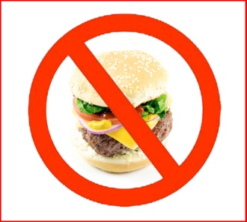
Prevention – Be an Industrial Athlete
Maintain a diet conducive to working in extreme heat.
Do not eat or drink:
  Alcohol (this
  “High Energy” Drinks
    Soda, Coffee, Tea, Energy drinks, and other beverages that contain caffeine.
  Spicy Foods
  High Protein Foods
    In extreme temperatures, it’s best to reduce your protein consumption. Not eliminate it all together, but cut back, and here’s why: Protein is really hard to digest. It takes a lot of different molecules and enzymes to transform a piece of meat into something the body can use. When your body performs this process, it creates heat — a process known as thermogenesis.
Notes:
Slide 10 Fitness for work.
We are all responsible to ensure we are fit for work.
Highlight de-hydrating effects of alcohol and caffeine based drinks.
Alcohol in moderation. Alcohol free days
Gastro. Highlight the dehydrating effect. Difficult to replace fluids. Seek medical advice

Slide 13
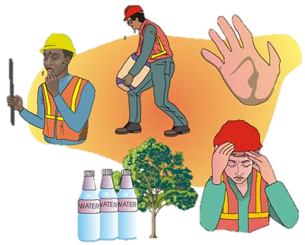
Personal Factors
Personal factors that affect your ability to cope
with heat
Age, weight and physical condition
Medical conditions such as diabetes, hypertension and heart disease
  See your doctor
Medications and drugs
Overweight, poor general health and poor physical fitness
Notes:
Slide 11 Personal factors
Medical conditions. Heart disease and or high blood pressure
Best to get this stuff checked out with you GP or have a health check with the Santos health and Lifestyle co-ordinator
Associated medications can mask symptoms of stress.
Some medications are diuretics
Over the counter medications. Cold and flu capsules dehydrating
Poor physical condition. Increase risk of heat stress. Body ability to cool its self decreased
(Layer of fat thick whales and blubber)
If you

Slide 14
Acclimatization
The body’s improved ability to withstand heat stress after repeated exposures to hot environments
If you are not used to working in the heat then you must take time to acclimatise. The general consensus is it takes about 14 days to acclimate properly.
Un-acclimatized
Increased hunger
Increased fatigue
Decreased concentration
Acclimatized
Increased sweat for cooling
More dilute sweat (lower salt loss)
Better recovery through sleep and rest
You may need to reduce workload during acclimatization
Notes:
Slide 12 Acclimatization
Need time to acclimatize.
Remember returning from extended breaks and or holidays.
Overseas workers
2006 workers coming in from Canada. Minus temps to 40 degrees in less than 48 hours.

Slide 15
Electrolyte and Sports Drinks
There is usually enough salt in a normal diet to replace electrolytes lost by sweating
But if you work in high temperatures or have a high workload job, the consumption of reasonable quantities of electrolyte drinks may be of benefit
Notes:
Slide 14 Electrolyte drinks
Health diet. Electrolyte drinks usually not necessary.
Useful to re-hydrate if already dehydrated.
Use in moderation
Water still the best.
If you don’t like water use diluted to increase palatability

Slide 16
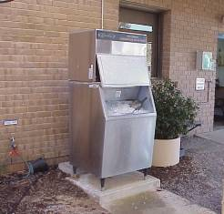
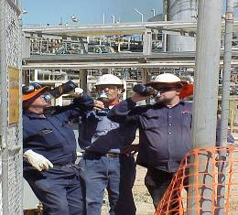
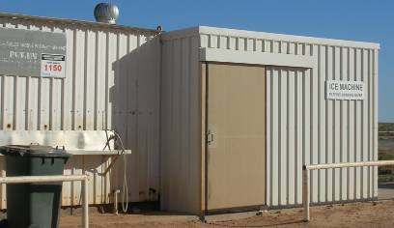
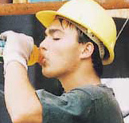
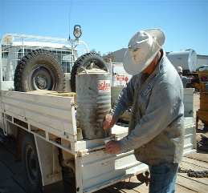
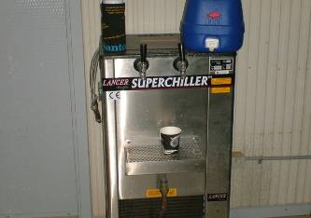
Keep Plenty of Cool Water on Hand
Also know where your supply of ice is
Notes:
Slide 15 Cool water on Hand
No where it is
Take plenty
Keep cool
Schedule regular drink breaks.
Use the scoops provided for ice machines

Slide 17
Controls- Prevention of Heat Stress
Heat Stress awareness information
Increase rest breaks
Avoid strenuous activities in the hottest part of the day
Air-conditioning service/repair early (including vehicles)
Job rotation
Shade, fans, ventilation and insulation
Notes:
Slide 16 Controls.
Ensure controls are in place before the heat arrives.
Make sure you have a maintenance schedule.
Train workers so they can rotate
Ensure your shade structures are ready to go and properly maintained.
Put fans in breeze ways for circulation

Slide 18
Controls- Prevention of Heat Stress (cont.)
Multiple water stations with electrolyte replacement
Supply and maintain ice machines
Air-conditioned break rooms
Drinks and break logs
Personal protective equipment – hats, sunglasses, water bottles, sunscreen, correct clothing
Notes:
Slide 17 Controls
Ensure you have adequate cool water.
Electrolyte drinks in moderation. Water is best
Long sleeve shirts
Wear a hat. Need to protect back of neck. Broad brims better than caps.
Distribute water bottles

Slide 19
What do we do if it Happens?
Mild
Heat rash
Heat cramps
Heat faint
Heat exhaustion
Heat stroke
Emergency
Notes:
Slide 24.

Slide 20
Heat Rash
Heat rash (Prickly Heat) is caused by the skin being continuously wet from unevaporated sweat causing itchiness, irritation and red skin
Keeping the skin cool and dry and some creams or powders can help
Notes:
Slide 25 Prickly heat
Known as sweat rash
See medical centre for creams or powders.
Should all be evaluated

Slide 21
Heat Cramps
Heat cramps are painful spasms of the muscles that are thought to be caused by a depletion of salts due to excessive sweating
Rest the affected person in a cool place and give them frequent small drinks of an electrolyte fluid
Notes:
Slide 26 Heat cramps
Like cramps when you played sport
As before
Can be a precursor to more serious conditions
Seek medical advice.

Slide 22
Heat Faint
Heat faint occurs when body fluids shift to the skin to cool the body down resulting in a drop in blood pressure
Rest the affected person in a cool place and give them frequent small sips of fluids
Notes:
Slide 28 Heat faint.
Report all incidences.
Seek medical advice before returning to work.
Lie person down in cool place.

Slide 23
Heat Exhaustion and Heat Stroke
Serious conditions that require immediate treatment
Due to a combination of increasing body temperature and severe dehydration
Heat Stroke must be treated as a medical emergency
Notes:
Slide 28 Heat Exhaustion Heat stroke
Now we have an emergency situation
Essential that you cool them quickly
D.R.A.B.C.
Probable unconscious.
Will not be able to take fluid.
Keep them in a call place
Call for medical assistance
Cool them by using cool wet cloths
Pack ice into the armpits and groin areas

Slide 24
Early Warning Signs of Heat Illness
Muscle cramps in the limbs or stomach
Urine getting dark
Not passing much urine
Nausea and vomiting
Headaches
Dizziness, confusion and fainting
Notes:
Slide 29 early Warning Signs
If any of these signs present you must seek further medical advice.
Cramps and headaches can occur at end of day.
Seek medical advice if cramps persist.
Do not drink alcohol if cramping, dizzy or faint.

Slide 25
If Heat Exhaustion or Heat Stroke are Suspected
Immediately seek medical assistance
Follow the First Aid principles: Danger Response Airway Breathing Compression
Get the affected person out of the heat and begin COOLING them down by spraying with water and fanning down or using ice packs.
Notes:
Slide 31 Suspect Heat Exhaustion Heat stroke
Can pack ice packs around the armpits and groin.
Cool them down most important.
Remember if they are not breathing or not breathing effectively you must assist them

Slide 26
Have a “cool” Summer

